Slide 1
Changes in the burden of cholera in Africa from 2011 to 2020
Country focus: Zambia Infectious Disease Dynamics Group at Johns Hopkins University

Slide 2
Introduction
Our project aims to produce continent-wide maps of mean annual incidence of suspected cholera cases across Africa from 2011-2020.
The maps are based on publicly available data (cholera-taxonomy.middle-distance.com) or confidential data that you, your colleagues, regional stakeholders, or other GTFCC partners contributed for research purposes.

Slide 3
Who will use these maps?
We anticipate that the maps will be used by country and regional cholera control managers and stakeholders, GTFCC partners, donors, and researchers to understand the magnitude of burden and the spatial distribution of suspected cholera across Africa.

Slide 4
How will these maps be used?
To forecast potential OCV demand and number of people living at high risk of V. cholerae exposure
To identify potential priority areas for cholera control
To advocate for funding for national cholera plans and other cholera control activities
To summarize the epidemiologic situation of cholera in a country or region
To understand the stability of cholera burden hotspots over a 10-year period

Slide 5
Why did we contact you?
As an expert in cholera control for your region, we would like your help in verifying the accuracy of the maps we produced.
We invite you to provide feedback on our modeled estimates, join us as a co-author on our manuscript about cholera burden in Africa from 2011-2020, and use the images in these slides for your own presentations about the epidemiologic situation of cholera in your region.
Please refer to our initial email and on how to provide your feedback on the figures and tables in this presentation. Email elizabeth.c.lee@jhu.edu for further questions.

Slide 6
Presentation Outline
Part 1. Continent-wide maps – These are the results that we will present in our manuscript.
Part 2. Country-specific maps – Please evaluate the accuracy of these figures in the feedback form.
Part 3. Data Coverage in Zambia – This summarizes the data we used in our model for your country.
Part 4. Model Fit for Zambia– This shows the robustness of the model fit for your country.

Slide 7
Part 1. Continent-wide maps

Slide 8
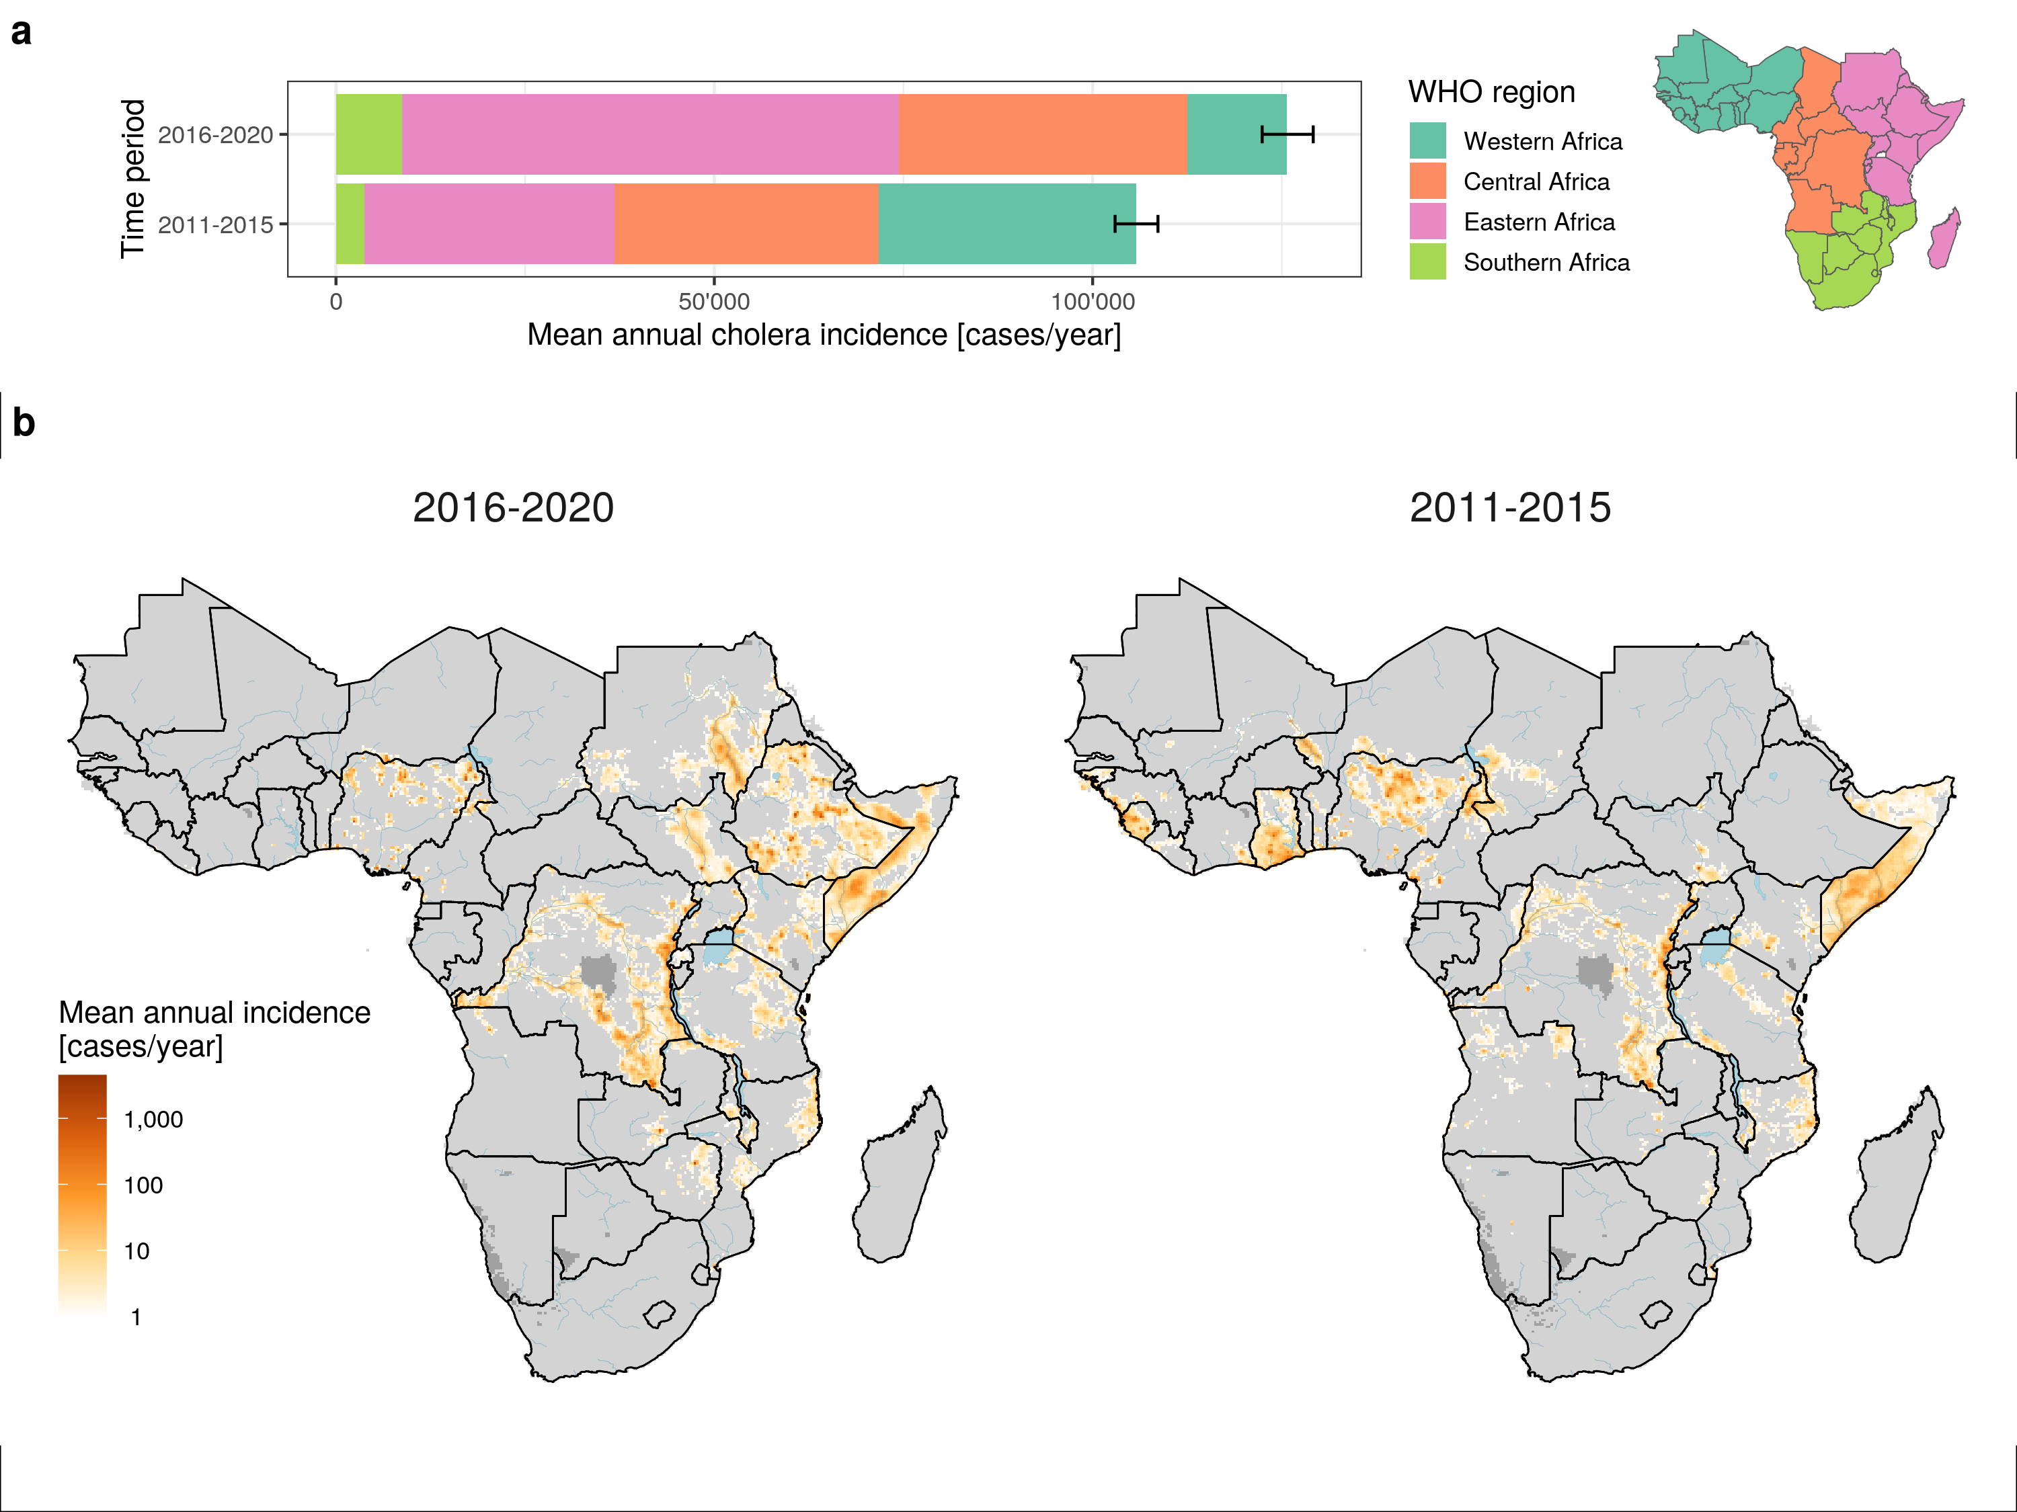
Figure 1. Distribution of mean annual incidence of suspected cholera cases, 2011-2020
Notes:
Figure 1. Distribution of mean annual incidence cases between 2011-2020. This set of figures aim to show the distributions of mean annual cholera incidence cases in Africa across two modeling time periods (2011-2015 and 2016-2020), as well as the distributions of cholera incidence cases across different WHO regions in Africa.
Panel A shows the distributions of mean annual incidence cases (mean suspected cholera cases per year) in Africa from 2011-2015 (left) and 2016-2020 (right). Areas in grey have a mean of less than 1 case per year. Blue shaded areas represent large lakes in Africa.
Panel B shows the mean annual cholera incidence (cases per year) across 2011-2015 and 2016-2020 by different African regions, including Western Africa (blue), Central Africa (orange), Eastern Africa (pink) and Southern Africa (green). The error bars represent the 95% prediction interval (uncertainty) at the continent-wide mean annual cholera incidence cases.

Slide 9
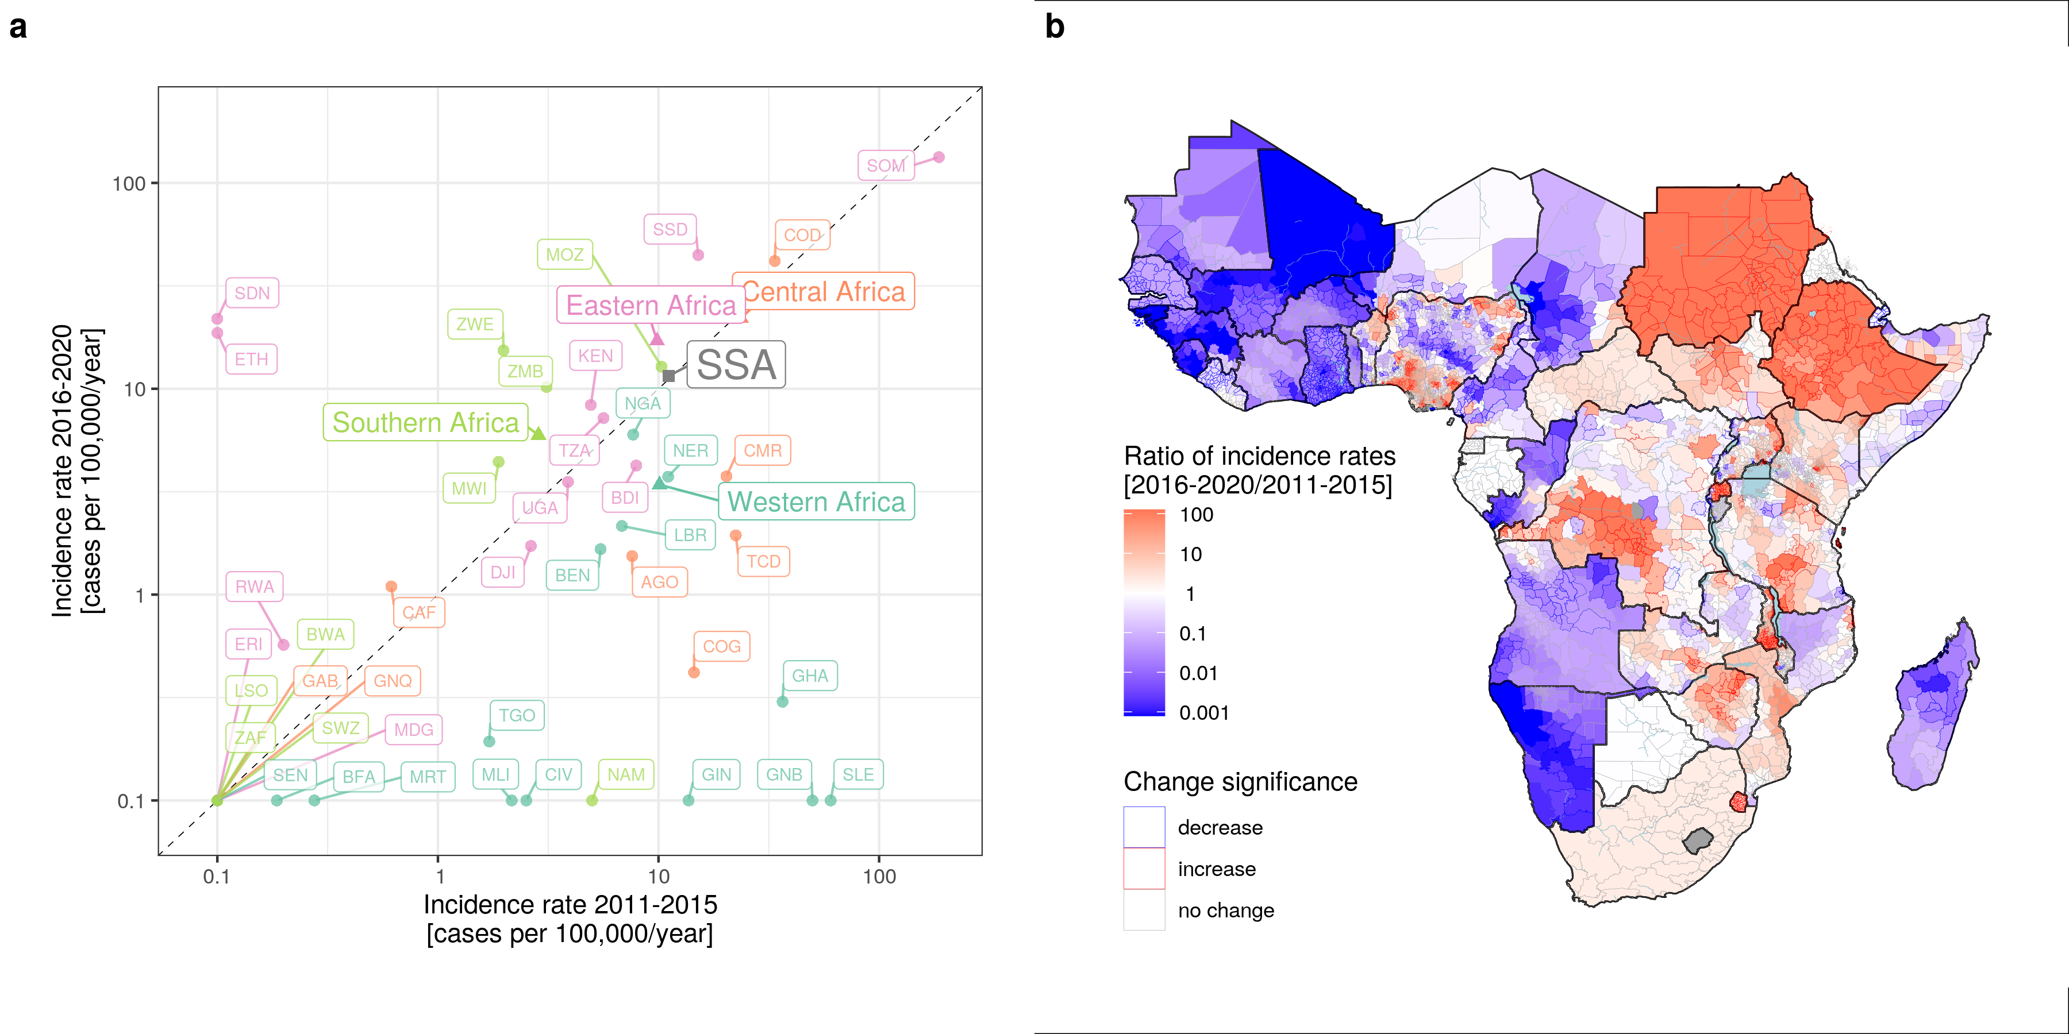
Figure 2. Changes in mean annual incidence rate
Notes:
Figure 2. Changes in mean annual incidence rate (cases per 100,000 per year) This set of figures aim to show the changes of mean annual incidence rate (mean suspected cholera cases per 100,000 per year) between 2011-2015 and 2016-2020 at the country and second-administrative levels.
Panel A shows a scatterplot whose y-axis is the mean annual incidence rates in 2016-2020 and x-axis is the mean annual incidence rates in 2011-2015 by country (three-letter ISO country code), region(Western Africa (blue), Central Africa (orange), Eastern Africa (pink) and Southern Africa (green)) and continent (labeled as “SSA”).
Panel B shows the ratio of mean annual incidence rates in 2016-2020 relative to 2011-2015. Areas filled with red had higher mean rates in 2016-2020 compared to 2011-2015, and areas filled with blue had lower mean rates in 2016-2020 compared to 2011-2015. Areas filled with white had similar mean rates in 2016-2020 and 2011-2015. Areas outlined in red or blue showed statistically significant increases (red) or decreases (blue) of mean rates in 2016-2020 relative to 2011-2015. Areas outlined in grey represent non-significant differences.

Slide 10
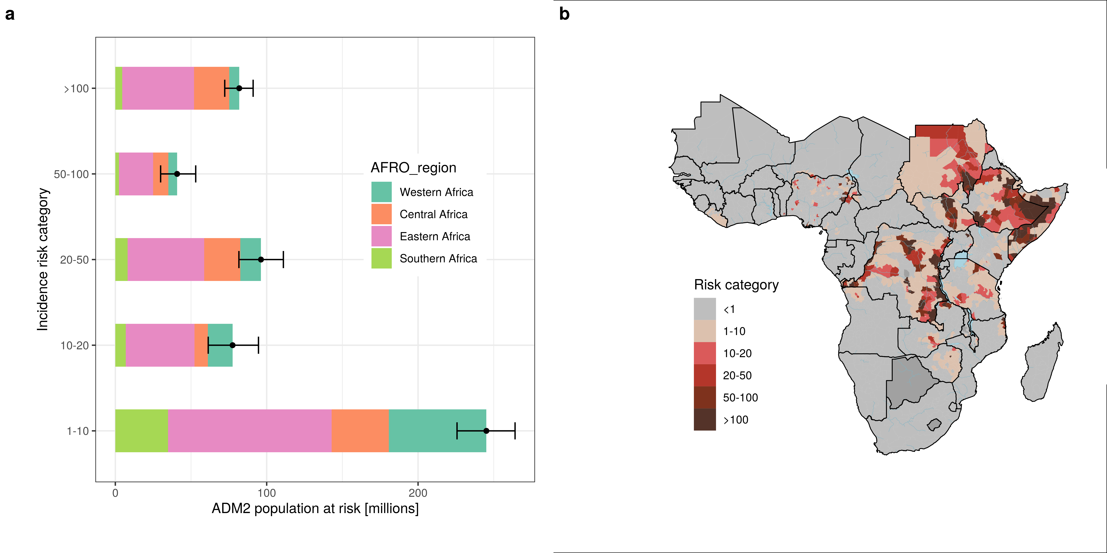
Figure 3. Population at risk, 2016-2020
Notes:
Figure 3. Population at risk, 2016-2020. This set of figures aim to show the population (number of people) living in areas according to incidence rate risk categories in 2016-2020 by region, and second-level administrative unit. There are six incidence rate risk categories from low to high risk, including <1 person per 100,000 population, 1-10 people per 100,000 population, 10-20 people per 100,000 population, 20-50 per 100,000 population, 50-100 per 100,000 population, and >100 per 100,000 population.
Panel A shows the population living in the second-level administrative districts, where we have high confidence that at least 10% of the population or >100,000 people in 2020 are living in grid cells at or above a 2016-2020 mean annual incidence rate indicated by the risk category color (e.g., >100 per 100,000 population, >50-100 per 100,000 population, >20-50 per 100,000 population, etc). Different colors represent different African regions.
Panel B shows the distribution of district-level population living in a given incidence risk category across Africa. Regional population distributions are indicated by different colors. A district (administrative 2 level unit) sample was assigned to a given risk category if at least 10% of the population or >100,000 people in 2020 were living in grid cells with a 2016-2020 mean annual incidence rate indicated by the risk category label.

Slide 11
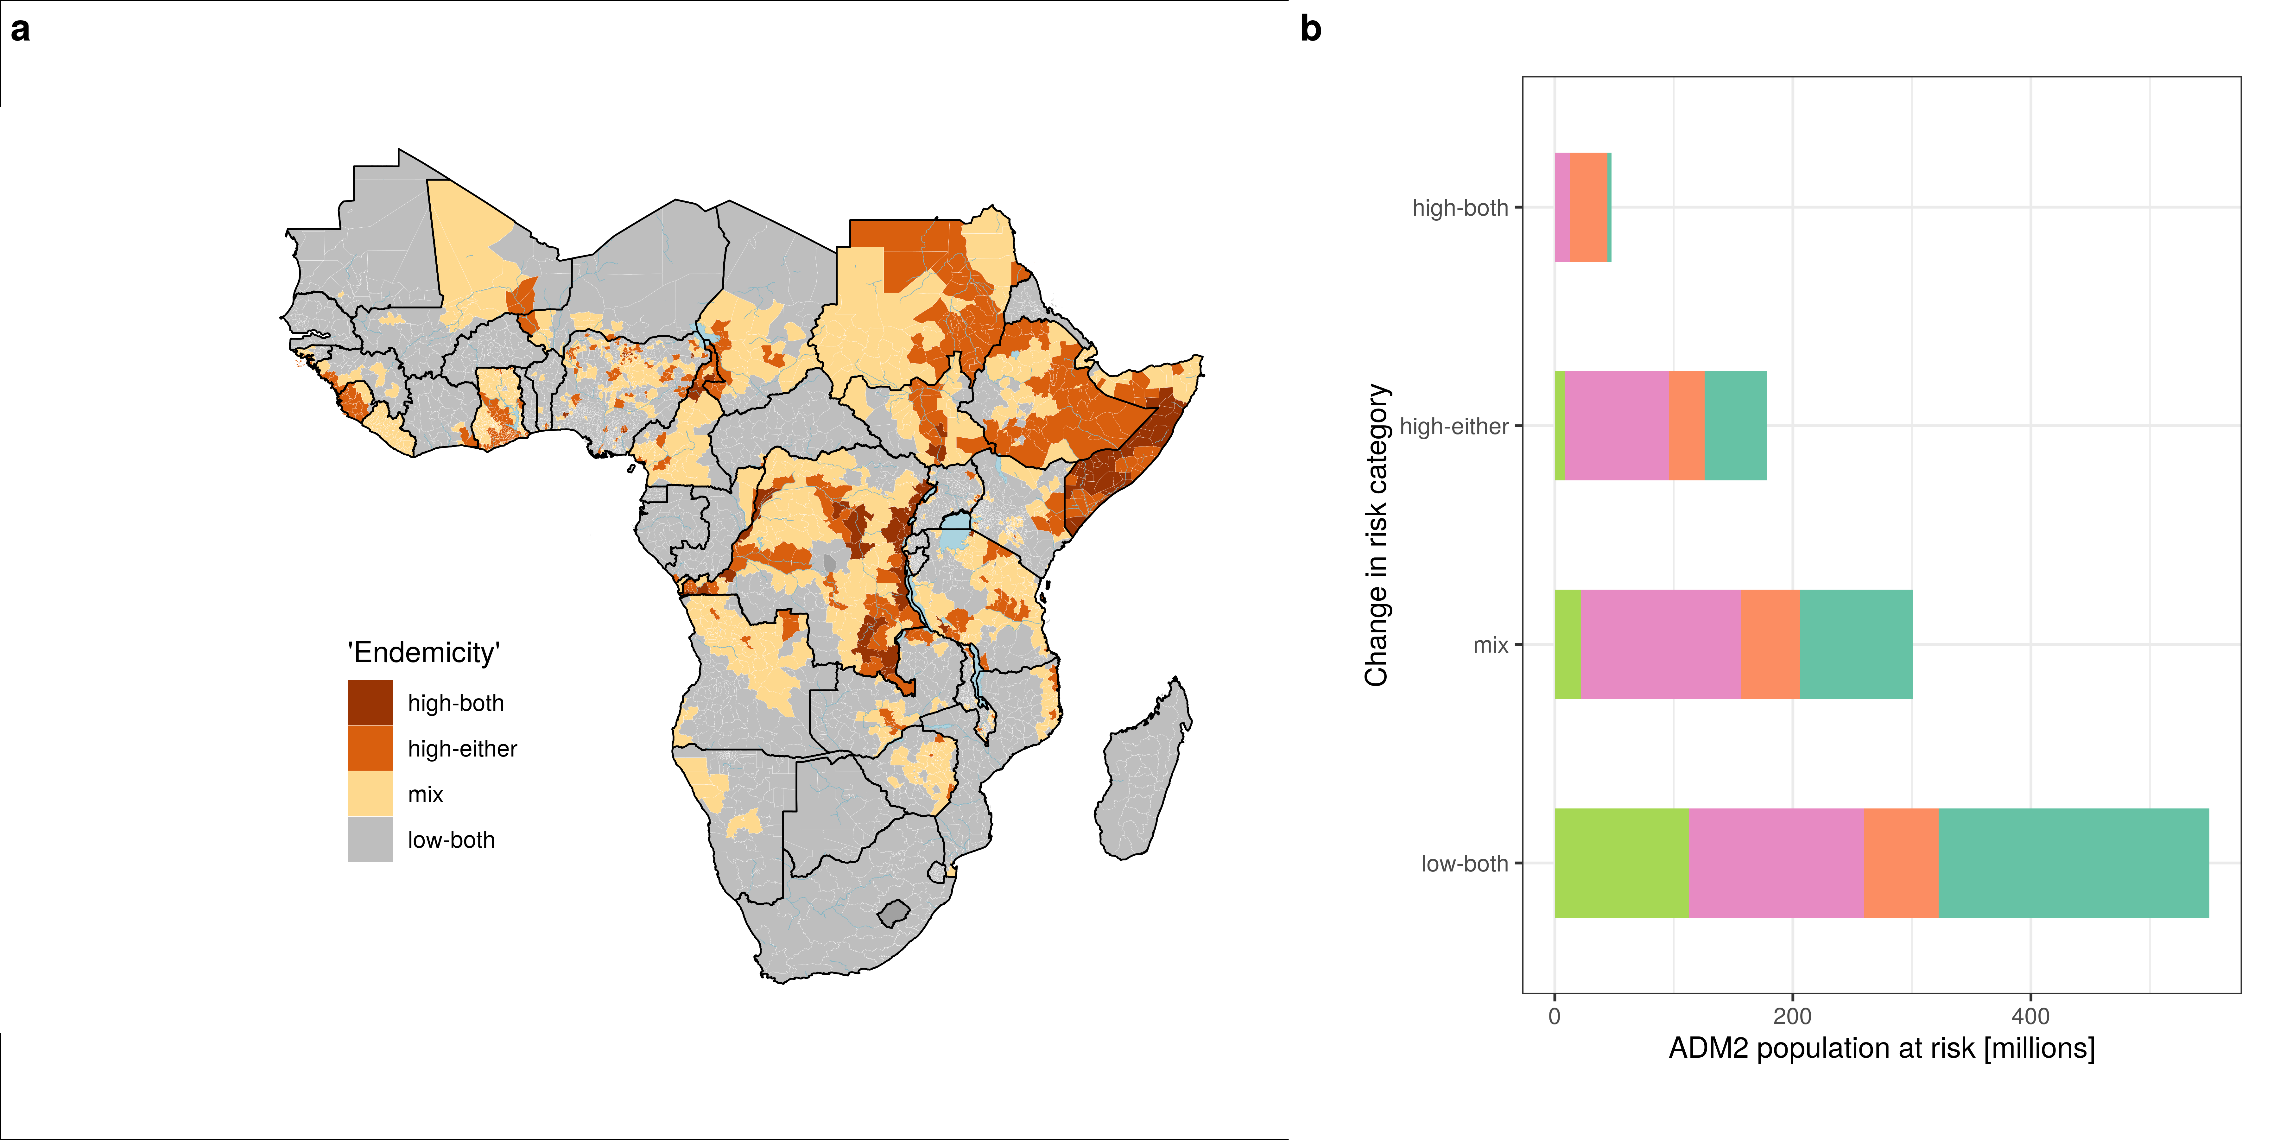
Figure 4 Stability of risk classification across 2011-2015 and 2016-2020
Notes:
Figure 4. Stability of risk classification in Africa across 2011-2010 This set of figures aim to show the stability of cholera risk classification of the second-level administrative districts across 2011-2015 and 2016-2020. There are four cholera risk categories, including “High-both” (districts were assigned to a high risk category of >10 per 100,000 in both periods), “High-either” (districts were assigned to a high risk category of >10 per 100,000 in exactly one period), “Low-both” (districts were assigned to a low risk category of <1 per 100,000 in both periods), and “Mix” (districts had a moderate risk category of >1 and <10 per 100,000 in both periods or a moderate and low risk category in one period each).
Panel A shows the stability of cholera risk category for districts where we have high confidence in assigning them into high or low risk incidence rate categories across 2011-2015 and 2016-2020 periods.
Panel B shows the 2020 population living in second-level administrative districts in a given high confidence stability category across 2011-2015 and 2016-2020 periods.

Slide 12
Part 2. Focus on: Zambia

Slide 13
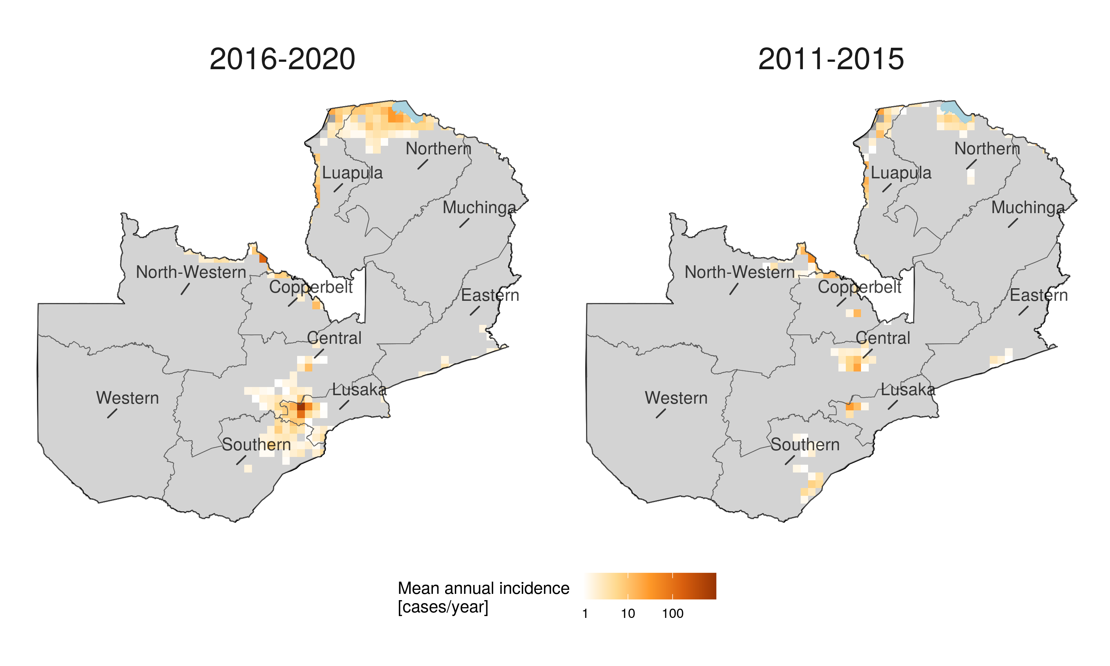
Figure 5. Mean annual incident cases: Zambia
Notes:
Figure 5. Distribution of mean annual incidence cases in Zambia between 2011-2020. This set of figures aim to show the distributions of mean annual cholera incidence cases in Zambia across two modeling time periods (2011-2015 (left) and 2016-2020 (right)).

Slide 14
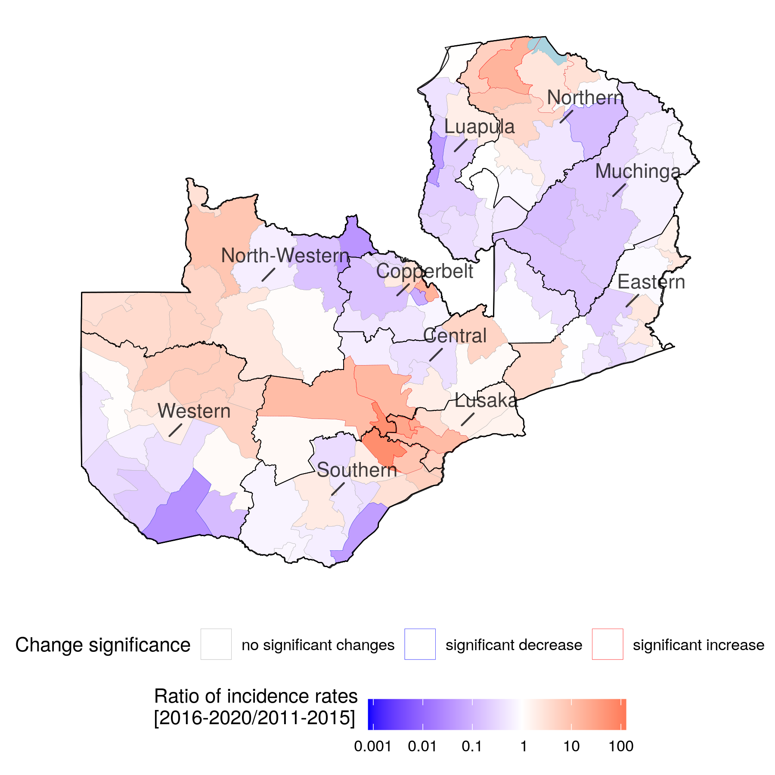
Figure 6. Incidence rate ratio from 2016-2020 to 2011-2015: Zambia
Notes:
Figure 6. Changes in mean annual incidence rate (cases per 100,000 per year) in Zambia This figure aims to show the changes of mean annual incidence rate (mean suspected cholera cases per 100,000 per year) between 2011-2015 and 2016-2020 at second-administrative levels in Zambia.
The colors represent the ratio of mean annual incidence rates in 2016-2020 relative to 2011-2015 in Zambia. Areas filled with red had higher mean rates in 2016-2020 compared to 2011-2015, and areas filled with blue had lower mean rates in 2016-2020 compared to 2011-2015. Areas filled with white had similar mean rates in 2016-2020 and 2011-2015. Areas outlined in red or blue showed statistically significant increases (red) or decreases (blue) of mean rates in 2016-2020 relative to 2011-2015. Areas outlined in grey represent non-significant differences.

Slide 15
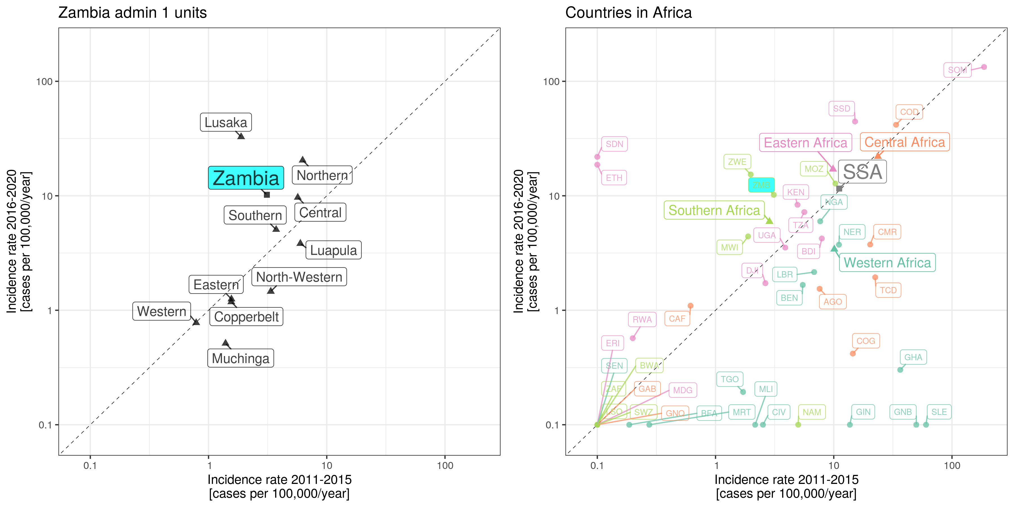
Figure 7. Changes in mean annual incidence rate: Zambia
Notes:
Figure 7. Changes in mean annual incidence rate (cases per 100,000 per year) in Zambia This set of figures aim to show the changes of mean annual incidence rate (mean suspected cholera cases per 100,000 per year) between 2011-2015 and 2016-2020 at the country and first-administrative levels. The country labels are highlighted in blue across both figures.
The left figure shows a scatterplot whose y-axis is the mean annual incidence rates in 2016-2020 and x-axis is the mean annual incidence rates in 2011-2015 by first-administrative units, and country in Zambia.
The right figure is the same as panel A in Figure 2, showing the change of mean annual incidence rate across 2011-2015 and 2016-2020 at the country, region and continent levels.

Slide 16
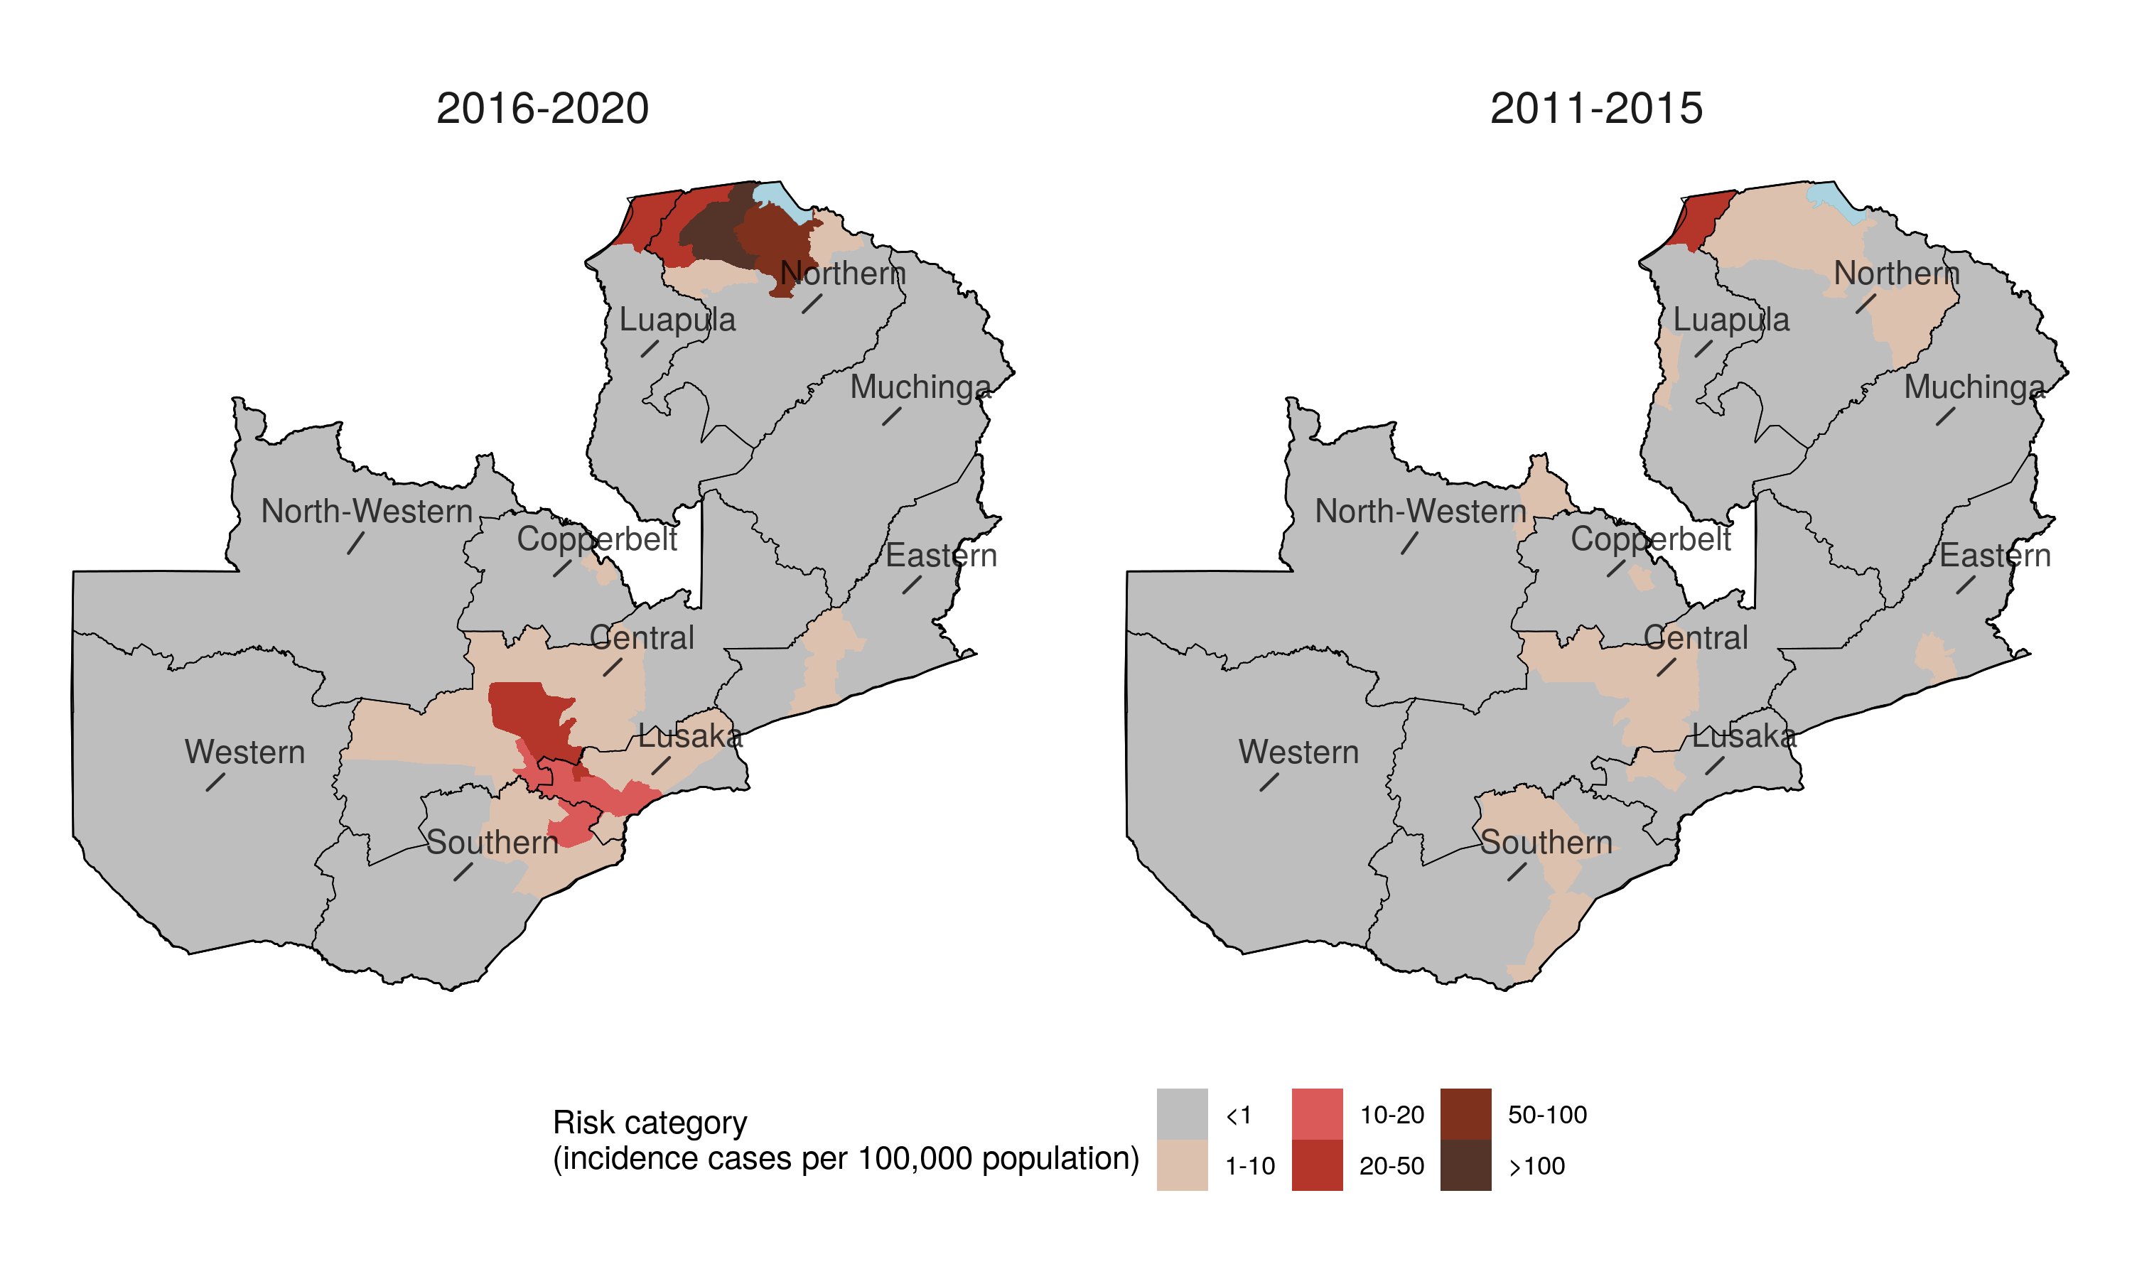
Figure 8. Second administrative level districts by incidence risk category: Zambia
Notes:
Figure 8. Population at risk, 2016-2020, in Zambia. This set of figures aim to show the population (number of people) living in areas according to incidence rate risk categories in 2016-2020 by second-level administrative unit. There are six incidence rate risk categories from low to high risk, including <1 person per 100,000 population, 1-10 people per 100,000 population, 10-20 people per 100,000 population, 20-50 per 100,000 population, 50-100 per 100,000 population, and >100 per 100,000 population.
The left and right figure shows the distribution of second-level administrative district population living in a given incidence risk category acrossZambia in 2011-2015 and 2016-2020 respectively. A district (second-level administrative unit) sample was assigned to a given risk category if at least 10% of the population or >100,000 people in 2020 were living in grid cells with a 2016-2020 mean annual incidence rate indicated by the risk category label. The names of first-level administrative units are also shown in the maps.

Slide 17
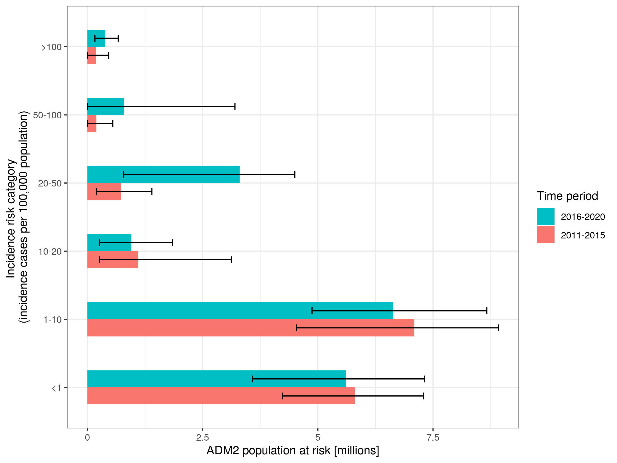
Figure 9. Population by incidence risk category and time period
Notes:
Figure 9. Population by incidence risk category and time perio in Zambia. This figures aims to show the population (millions) living in each incidence risk category (incidence cases per 100,000 population). The color represents different time periods (2011-2015 (red) and 2016-2020 (blue)).

Slide 18
Table 1. Number of people at the second administrative level in Zambia living in different cholera risk categories per time period
Risk category (per 100,000 population) | Mean Number [millions] (95% prediction interval) 2016-2020 | Mean Number [millions] (95% prediction interval) 2011-2015
>100 | 0.38 (0.16-0.67) | 0.18 (0-0.46)
50-100 | 0.79 (0-3.2) | 0.19 (0-0.55)
20-50 | 3.3 (0.78-4.5) | 0.72 (0.19-1.4)
10-20 | 0.95 (0.26-1.85) | 1.1 (0.26-3.12)
1-10 | 6.63 (4.87-8.67) | 7.09 (4.54-8.92)
<1 | 5.61 (3.58-7.32) | 5.8 (4.24-7.3)
Notes:
Table 1. Number of people at the second administrative level in Zambia living in different cholera risk categories per time period. This table summarizes the data in Figure 9 which aims to show the population (millions) living in each incidence risk category (incidence cases per 100,000 population). The color represents different time periods (2011-2015 (red) and 2016-2020 (blue)).

Slide 19
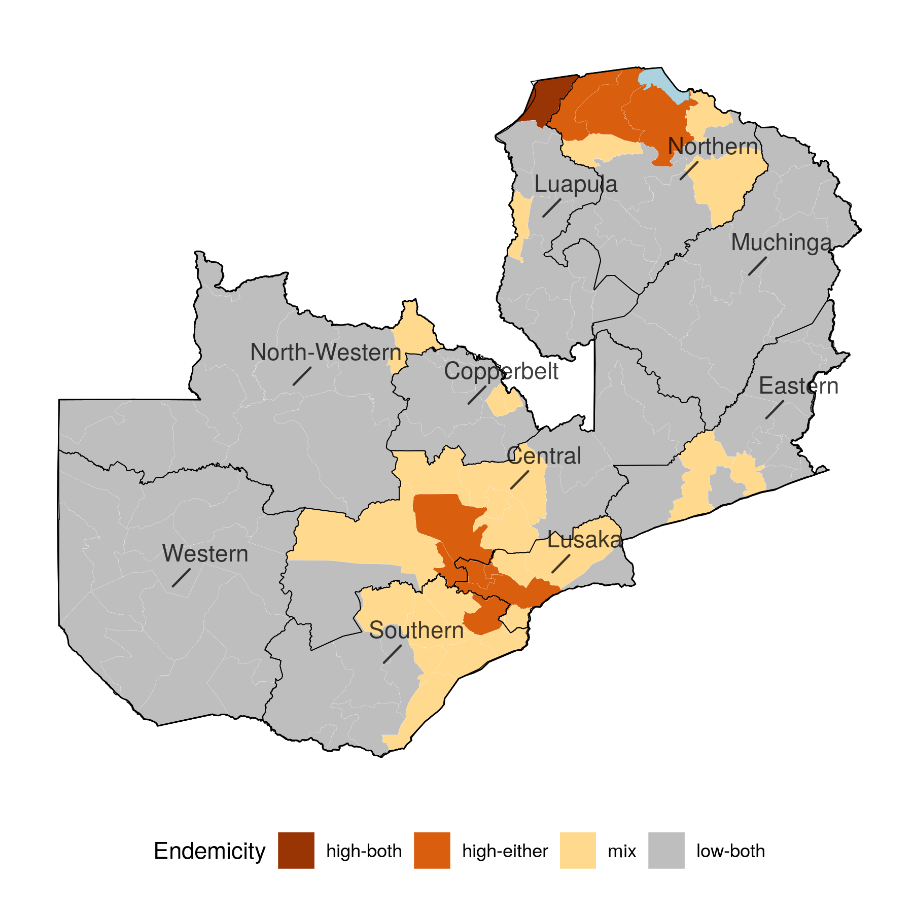
Figure 10. Stability of risk classification across 2011-2015 to 2016-2020
Notes:
Figure 10. Stability of risk classification in Zambia across 2011-2010 This set of figures aim to show the stability of cholera risk classification of the second-level administrative districts across 2011-2015 and 2016-2020 in Zambia. There are four cholera risk categories, including “High-both” (districts were assigned to a high risk category of >10 per 100,000 in both periods), “High-either” (districts were assigned to a high risk category of >10 per 100,000 in exactly one period), “Low-both” (districts were assigned to a low risk category of <1 per 100,000 in both periods), and “Mix” (districts had a moderate risk category of >1 and <10 per 100,000 in both periods or a moderate and low risk category in one period each). The color shows the stability of cholera risk category for districts where we have high confidence in assigning them into high or low risk incidence rate categories across 2011-2015 and 2016-2020 periods. The names of first-level administrative units are also shown in the maps.

Slide 20
Part 3. Data coverage in Zambia

Slide 21
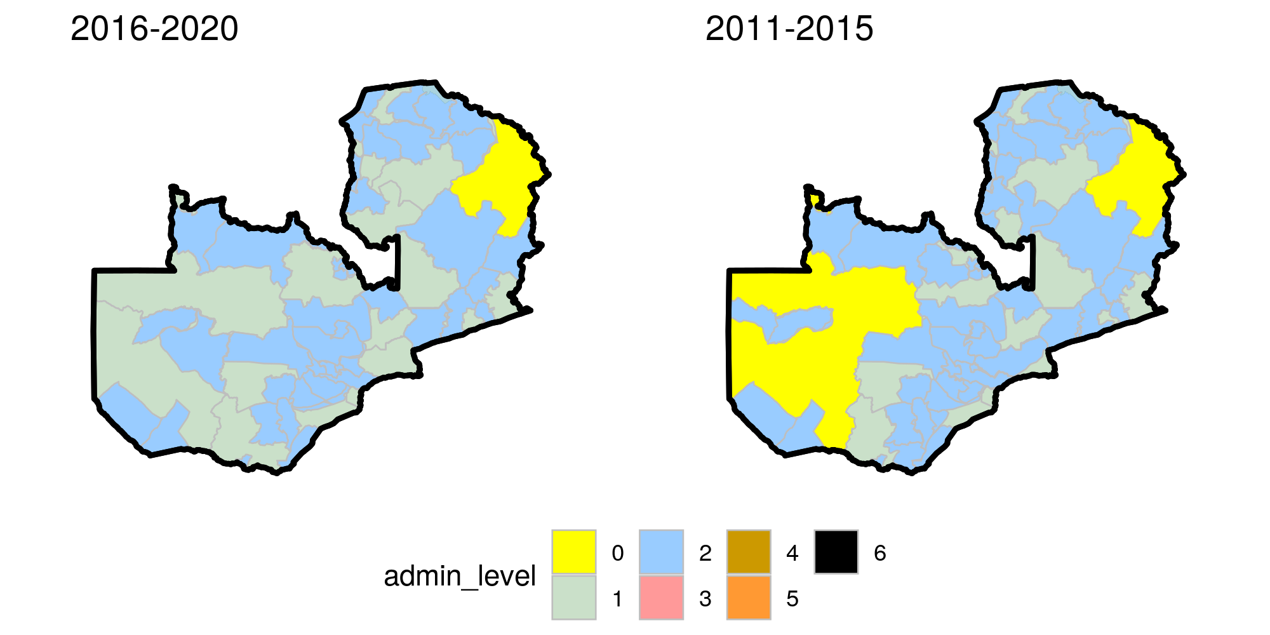
Figure 11. Country-specific data coverage map across 2011-2015 to 2016-2020
Notes:
Figure 11. Data coverage map across 2011-2015 to 2016-2020 in Zambia.
These figures show the smallest administrative level (color) where at least one observation was reported in 2011-2015 (left) and 2016-2020 (right).

Slide 22
Table 2. Number of data points by year for Zambia
Year | National level | First-level administrative units | Second-level administrative units
2011 | 2 | 8 | 74
2012 | 2 | 4 | 78
2013 | 1 | 2 | 92
2014 | 1 | 0 | 94
2015 | 1 | 0 | 91
2016 | 2 | 1 | 100
2017 | 4 | 19 | 107
2018 | 2 | 15 | 72
2019 | 3 | 2 | 6
2020 | 1 | 0 | 0
Notes:
Table 2. Number of data points by year for Zambia This table summarizes the number of data points (observations) for each year covered by national, first-level administrative units and second-level administrative units.

Slide 23
Part 4. Model Fit for Zambia

Slide 24
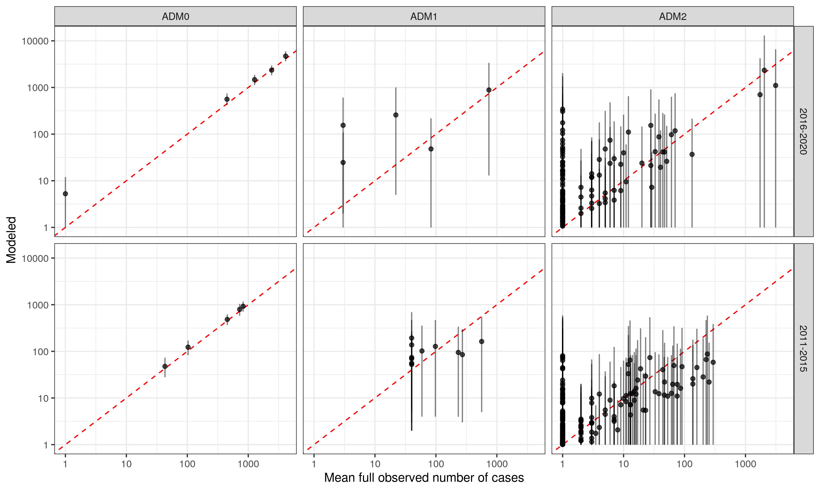
Figure 12. Observed cases versus modeled cases across 2011-2015 and 2016-2020
Notes:
Figure 12. Observed cases versus modeled cases across 2011-2015 and 2016-2020.
Model validation for full (not time-censored) observations at the country, admin 1, and admin 2 level for the two periods on the log scale. Modeled case estimates show the mean (point) and 95% prediction interval (line). The model fits the data well if the prediction interval crosses the one-to-one diagonal line for 95% of the observations.”

